Slide 1

Group 7
WEATHER ANALYSIS
Aditi Garg
Ali Shanaa
Brendan Smith
Neha Changela
Rafael Martinez
Ruqayyah Shariah
Notes:
Aditi - INTRO

Slide 2
Agenda
Introduction: Project Execution Steps
- How did we source the data?
- What in the topic piqued our interest?
- Tools
Deep Dive into the analytics
( visualizations and explanations )
Conclusion
Questions
Notes:
TBD - Olesya

Slide 3
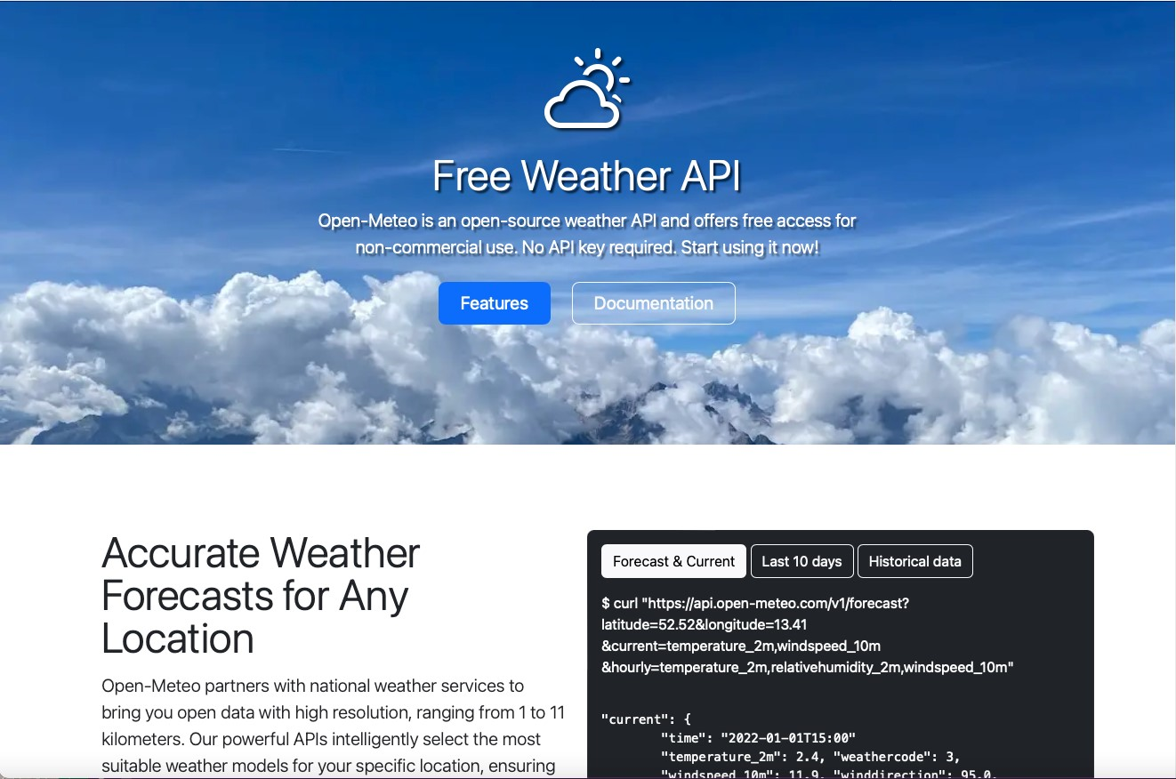
Notes:
Vig

Slide 4
Historic Temp, precipitation, and sea level for cities (New York, Beijing, London, Tokyo, Mexico City) 10yrs
https://archive-api.open-meteo.com/v1/archive?latitude=40.71,39.9,51.5,35.67,19.43&longitude=74,116.4,0.12,139.65,99.13&start_date=2010-01-01&end_date=2019-12-31&hourly=pressure_msl&daily=temperature_2m_max,precipitation_sum&timezone=America%2FNew_York
Co emissions and UV index (New York, Beijing, London, Tokyo, Mexico City) 1yr
https://air-quality-api.open-meteo.com/v1/air-quality?latitude=40.71,39.9,51.5,35.67,19.43&longitude=74,116.4,0.12,139.65,99.13&hourly=carbon_monoxide,uv_index&start_date=2022-10-01&end_date=2023-10-01
Co emissions and UV index (Zurich, Honolulu, Reykjavik, Hobart, Funchal) 1yr
https://air-quality-api.open-meteo.com/v1/air-quality?latitude=47.37,21.3,64.14,-42.88,32.65&longitude=8.54,157.85,-21.94,147.32,16.9&hourly=carbon_monoxide,uv_index&timezone=America%2FNew_York&start_date=2022-10-01&end_date=2023-10-01
Historic Temp, precipitation, and sea level for cities (Zurich, Honolulu, Reykjavik, Hobart, Funchal) 10yrs
https://archive-api.open-meteo.com/v1/archive?latitude=47.37,21.3,64.14,-42.88,32.65&longitude=8.54,157.85,-21.94,147.32,16.9&start_date=2010-01-01&end_date=2019-12-31&hourly=pressure_msl&daily=temperature_2m_max,precipitation_sum&timezone=America%2FNew_York
7.37,8.54 – Zurich/Switzerland
21.30,157.85 – Honolulu/USA
64.14, -21.94 – Reykjavik/Iceland
-42.88,147.32 – Hobart/Australia
32.65,16.90 – Funchal/Portugal
40.71,74.00 – New York City/USA
39.90,116.40 – Beijing/China
51.50,0.12 – London/UK
35.67,139.65 – Tokyo/Japan
19.43,99.13 – Mexico city/Mexico

Slide 5
Introduction
Welcome to our Climate Analysis project! In this project, we have conducted an analysis of climate data for five of the most polluted cities and five of the least polluted cities. The cities we focused on are New York City (NYC), Beijing, London, Tokyo, Mexico City, Zurich, Honolulu, Reykjavik, Hobart, and Funchal.

Slide 6
Introduction
Data Processing: We used the Pandas library in Jupyter Notebook to process and clean the data, resulting in a set of clean and readable CSV files. These CSV files are the basis of our analysis and visualization.
Database Creation: To facilitate data management, we created an SQL database named weather_db to house our processed climate data. This database is used to efficiently store and retrieve data for our project.
Data Transformation: Using terminal commands, we converted our clean CSV data into a SQLite database file named weather.sqlite. This allows for easy integration with various applications and platforms.
Flask Web Application: We built a Flask web application that connects to our weather.sqlite database. This application serves as the backend for our project, providing data to our front-end interface.
Notes:
Aditi

Slide 7
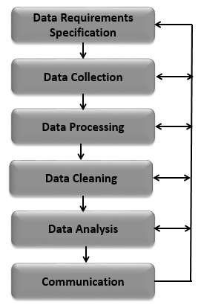
Project Execution Steps
Interactive Web Page: Our interactive web page is designed to provide users with an engaging and informative experience. It is built using HTML, JavaScript, and various JavaScript libraries, including Plotly, D3, and gif.js. Users can explore climate data through interactive charts, maps, and visualizations.
Flask Web Apllication:
Notes:
Olesya

Slide 8
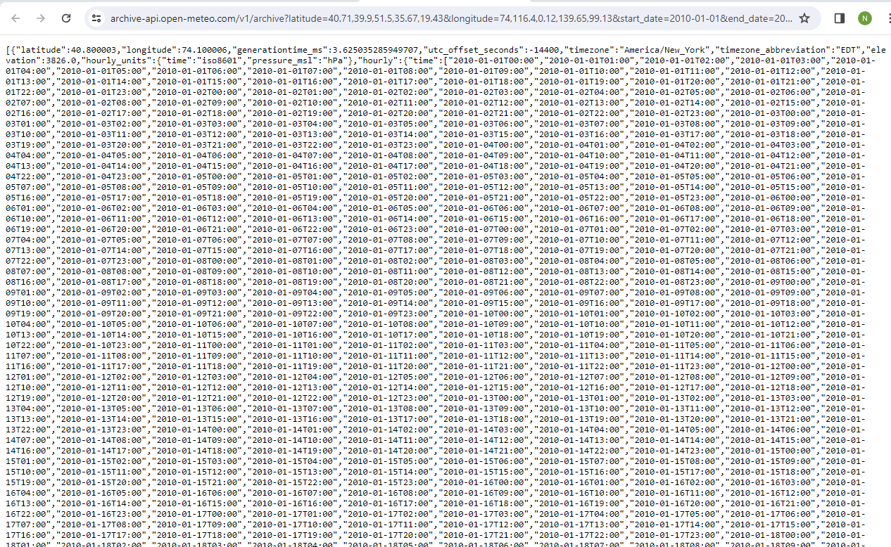
RAW DATA

Slide 9
CLEAN CSV DB

Slide 10
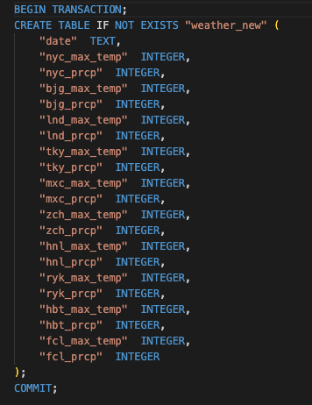
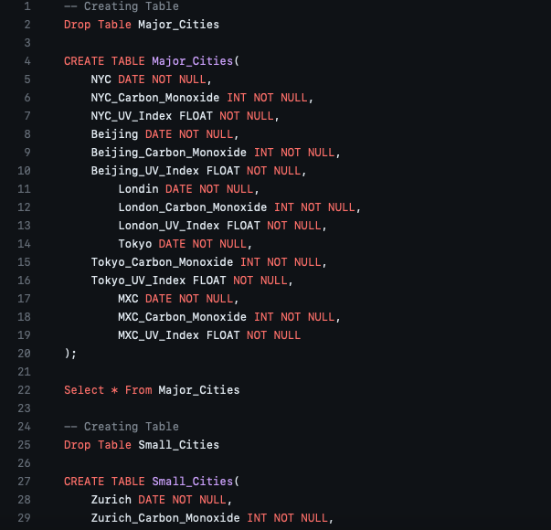
SQL DB

Slide 11
FLASK APP

Slide 12
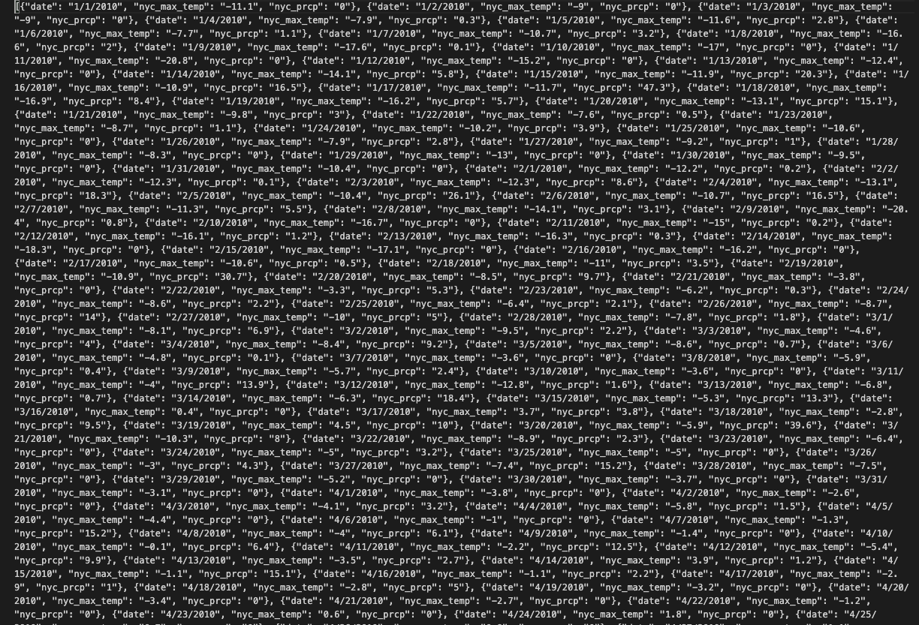
JSON FORMAT DATA

Slide 13
HTML CODE

Slide 14
JAVA SCRIPT

Slide 15
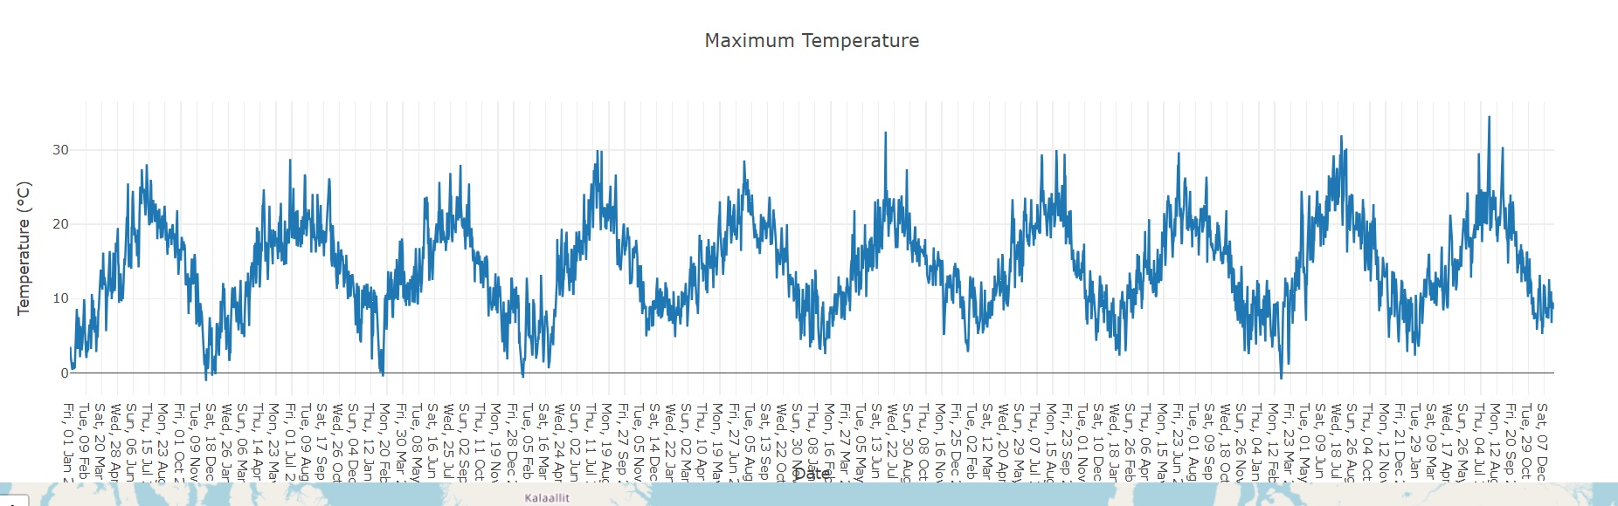

Slide 17

Limitations & Challenges
Finding a free API to use as our database
Cleaning and Sorting through the data – over 10 years of information
Connecting the flask with the HTML

Slide 18
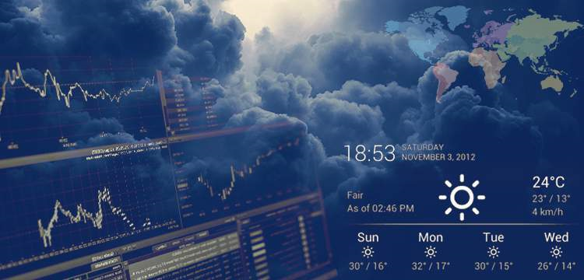


Slide 19
Group 7
THANK YOU
Aditi Garg
Neha Changela
Ruqayyah Shariah
Ali Shanaa
Rafael Martinez
Brendan Smith

